Slide 1
Dynamic Programming
8 -<number>

Slide 2
Dynamic Programming
Dynamic Programming is an algorithm design method that can be used when the solution to a problem may be viewed as the result of a sequence of decisions
8 -<number>
Notes:
Dynamic Programming is an algorithm design technique used to solve optimization problems by breaking them into smaller overlapping subproblems, solving each subproblem only once, storing their solutions, and combining them to obtain the optimal solution of the original problem.
🟢 Dynamic Programming (Simple Meaning)
👉 Dynamic Programming is a method where we:
Break a big problem into smaller problems
Solve each small problem only once
Save the answers
Use those saved answers to build the final solution

Slide 3
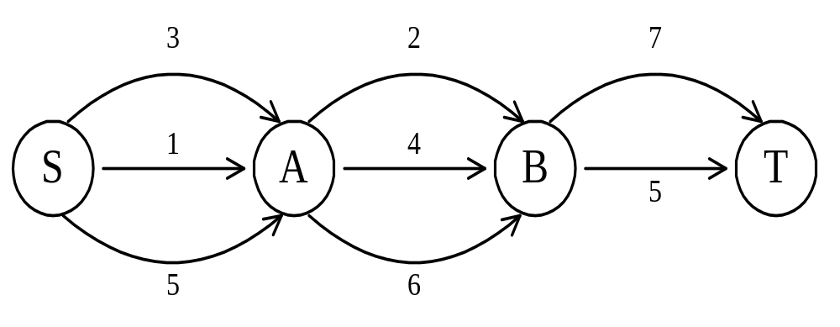
The shortest path
To find a shortest path in a multi-stage graph
Apply the greedy method :
the shortest path from S to T :
1 + 2 + 5 = 8
8 -<number>
Notes:
🟢 What is Greedy Method?
👉 Greedy method means:
At every step,
choose the best available option right now
without thinking about the future.
It does NOT go back.
It does NOT change decisions.
Even Shorter (for quick memory):
Greedy method means selecting the locally best choice at each step to get a solution.

Slide 4
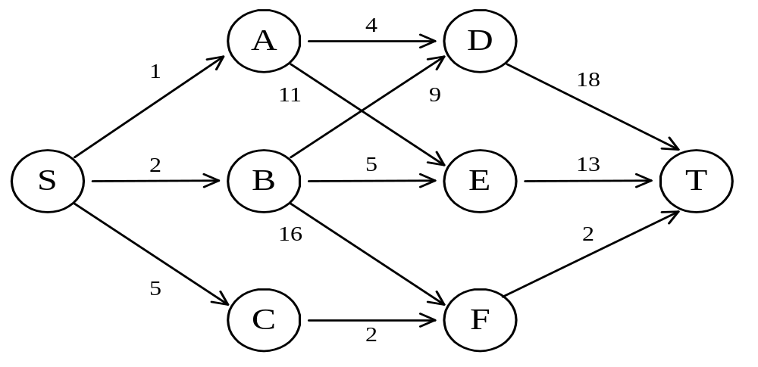
The shortest path in multistage graphs
e.g.
The greedy method can not be applied to this case: (S, A, D, T) 1+4+18 = 23.
The real shortest path is:
(S, C, F, T) 5+2+2 = 9.
8 -<number>

Slide 5
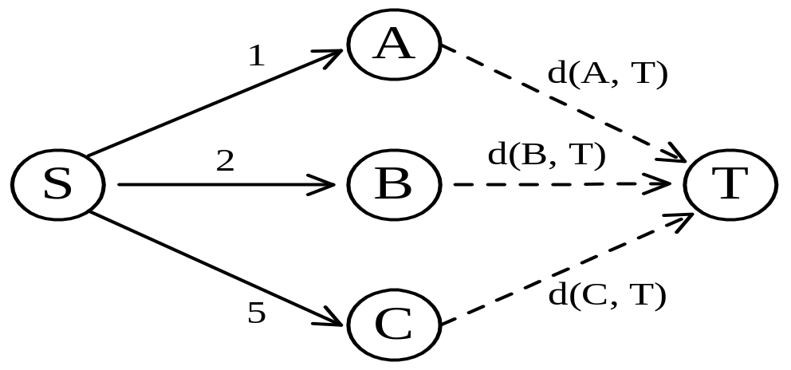
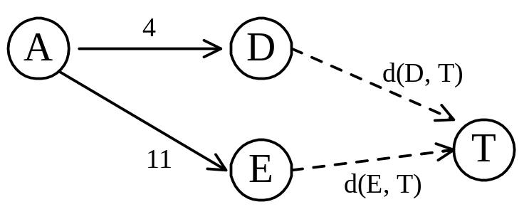
Dynamic programming approach
Dynamic programming approach (forward approach):
d(S, T) = min{1+d(A, T), 2+d(B, T), 5+d(C, T)}
d(A,T) = min{4+d(D,T), 11+d(E,T)}
= min{4+18, 11+13} = 22.
8 -<number>

Slide 6
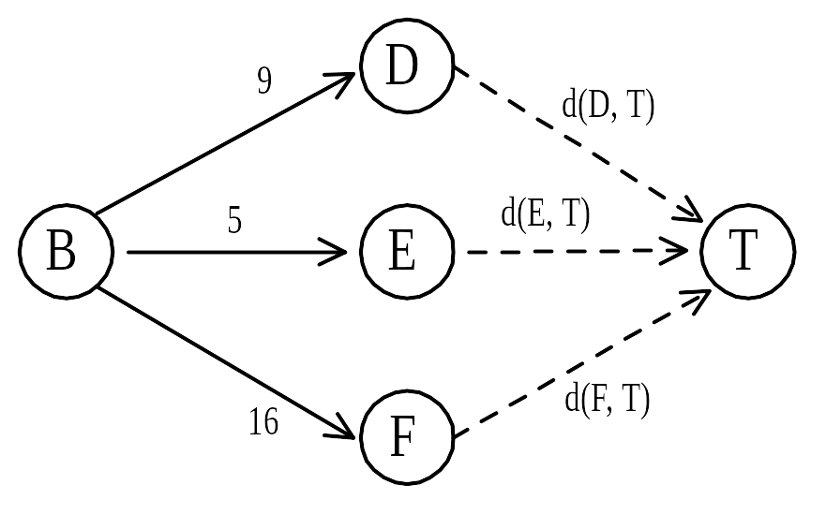
Dynamic programming
d(B, T) = min{9+d(D, T), 5+d(E, T), 16+d(F, T)}
= min{9+18, 5+13, 16+2} = 18.
d(C, T) = min{ 2+d(F, T) } = 2+2 = 4
d(S, T) = min{1+d(A, T), 2+d(B, T), 5+d(C, T)}
= min{1+22, 2+18, 5+4} = 9.
The above way of reasoning is called
backward reasoning.
8 -<number>

Slide 7
Backward approach
(forward reasoning)
d(S, A) = 1
d(S, B) = 2
d(S, C) = 5
d(S,D)=min{d(S, A)+d(A, D),d(S, B)+d(B, D)}
= min{ 1+4, 2+9 } = 5
d(S,E)=min{d(S, A)+d(A, E),d(S, B)+d(B, E)}
= min{ 1+11, 2+5 } = 7
d(S,F)=min{d(S, A)+d(A, F),d(S, B)+d(B, F)}
= min{ 2+16, 5+2 } = 7
8 -<number>

Slide 8
d(S,T) = min{d(S, D)+d(D, T),d(S,E)+
d(E,T), d(S, F)+d(F, T)}
= min{ 5+18, 7+13, 7+2 }
= 9
8 -<number>

Slide 9
Principle of optimality
Principle of optimality: Suppose that in solving a problem, we have to make a sequence of decisions D₁, D₂, …, D_{n}. If this sequence is optimal, then the last k decisions, 1 < k < n must be optimal.
e.g. the shortest path problem
If i, i₁, i₂, …, j is a shortest path from i to j, then i₁, i₂, …, j must be a shortest path from i₁ to j
In summary, if a problem can be described by a multistage graph, then it can be solved by dynamic programming.
8 -<number>

Slide 10
Dynamic programming
Forward approach and backward approach:
  Note that if the recurrence relations are formulated using the forward approach then the relations are solved backwards . i.e., beginning with the last decision
  On the other hand if the relations are formulated using the backward approach, they are solved forwards.
To solve a problem by using dynamic programming:
  Find out the recurrence relations.
  Represent the problem by a multistage graph.
8 -<number>

Slide 11
Multistage Graph
A multi stage graph G = (V,E) is a directed graph in which vertices are partitioned into K>=2 disjoint set where [1<=i<=k] in addition if (u,v) is an edge E then u€ v_{i}, v€v_{i+1}
Dijkstra = Greedy: Picks the nearest neighbor and never looks back.
Multistage Search = Dynamic Programming: Looks at all neighbors in a stage and calculates the best overall.

Slide 12
Multistage graph problem
Let C(i,j) be the cost of edge (I,j).
  The cost of a path from S to T is the sum of the costs of the edges on the path.
  The multistage graph problem is to find the minimum cost from S to T
  The values on the edges are called cost of edges.

Slide 13
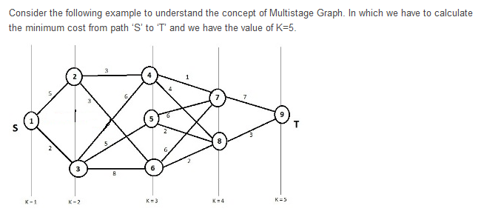

Example

Slide 14
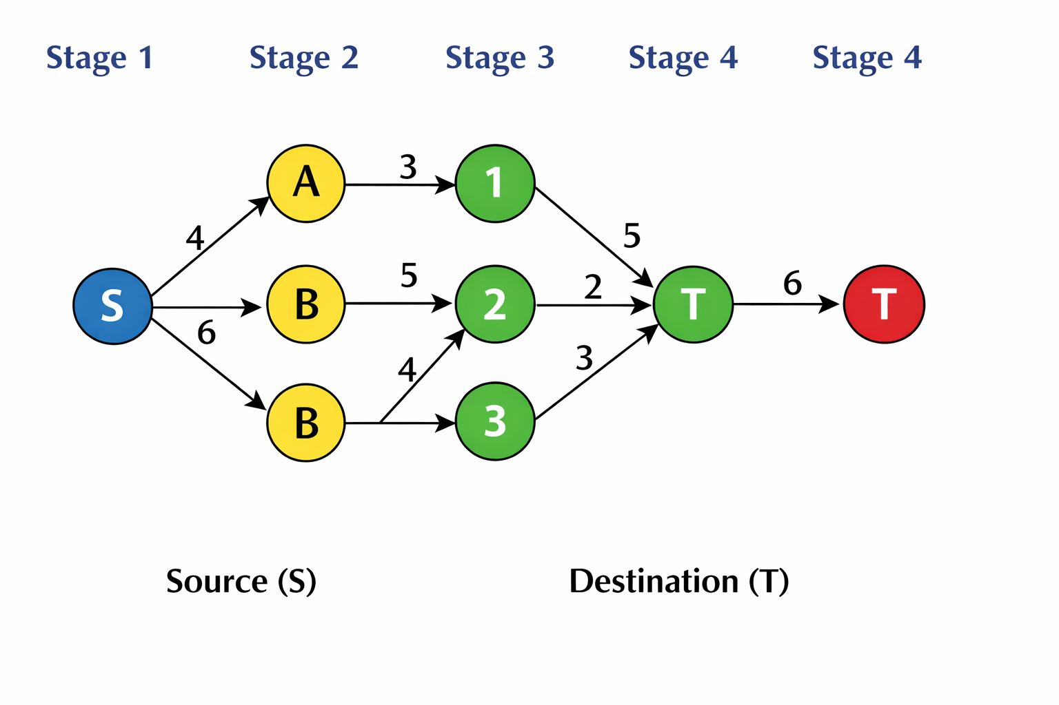
Example

Slide 15
Solution- Step -1
Use the formula to calculate the min cost(I,j).

Slide 16
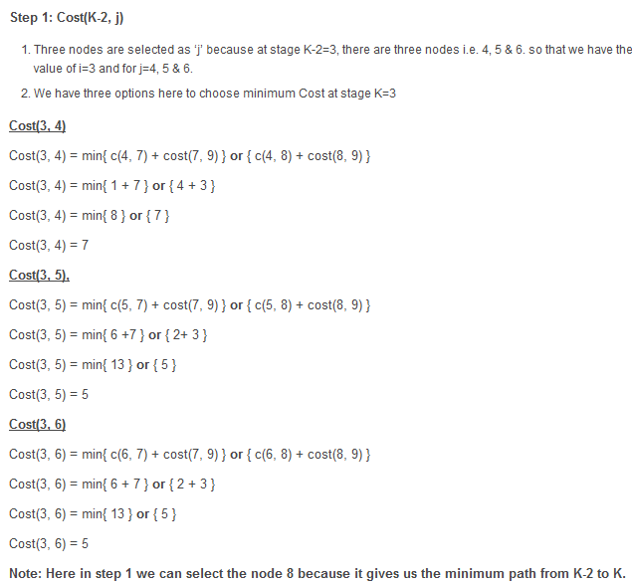

Slide 17
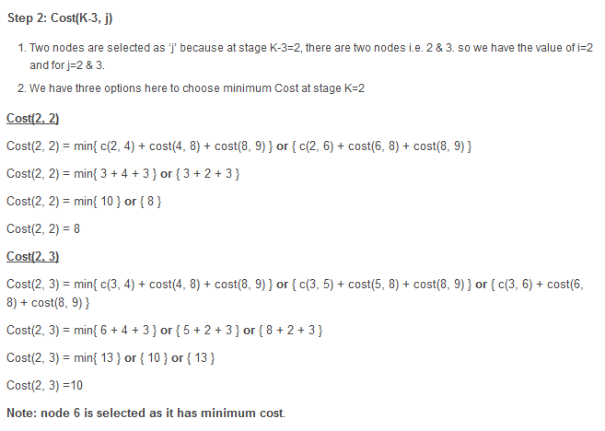

Slide 18
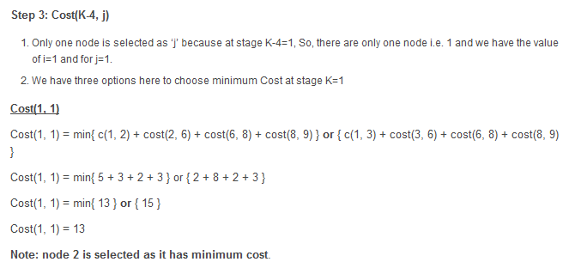


Slide 19
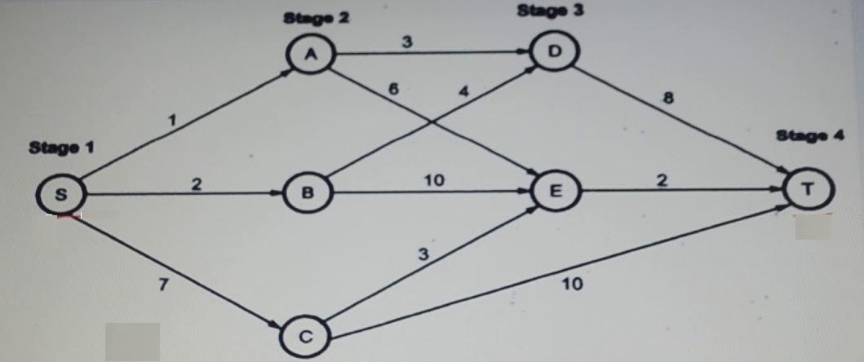
8 -<number>

